Slide 1
Robotic Process Automation Part 2
Acctg & Fin | BUS AN 500 | Class 04
Spring Qtr | 2026

Slide 2

What will we do today?
Review
Robotic Process Automation
Individual Submissions
Final Project Context Overview
Financial Performance & Forecasting
Budgeting and & FPA
Project Evaluation & Risk
Team Check-in
Workshop/Lab time
Individual RPA Submission (30%)

Slide 3
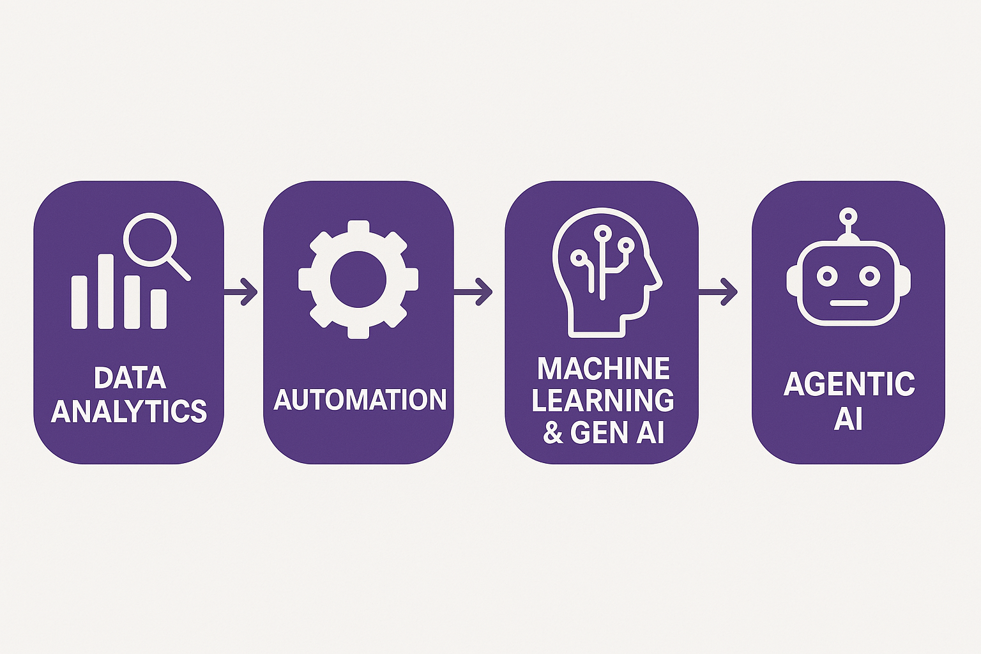
Course Diagram
Analytics workflows & pipelines

Slide 4
Course Diagram
Robotic Process Automation
(deterministic processes)

Slide 5
Course Diagram
Classes 5, 6, & 7

Slide 6
Accounting & Finance Function
External Users
Owners and other stakeholders
Banks
Internal Users
Users within a Company
Board of Directors
Managers
Employees
Investors
Shareholders
External Auditor
Creditors
Tax Agencies
Media
Students
Governments

Slide 7
What will we do today?
Review
Robotic Process Automation
Individual Submissions
Final Project Context Overview
Financial Performance & Forecasting
Budgeting and & FPA
Project Evaluation & Risk
Team Check-in
Workshop/Lab time
Individual RPA Submission (30%)

Slide 8
Individual Submissions
What if I can’t get the bot running?
That’s fine, demo to where it works, explain where you got stuck and explain the rest of the workflow in terms of what you planned to have it do.
Continue to explain the potential benefits of the bot (how many hours it could save, the types of human errors it can reduce).
What if I can’t find an activity that works in my workflow?
Consider alternatives, or,
Add a comment activity and write in what the plan for that step was.

Slide 9
What will we do today?
Review
Robotic Process Automation
Individual Submissions
Final Project Context Overview
Financial Performance & Forecasting
Budgeting and & FPA
Project Evaluation & Risk
Team Check-in
Workshop/Lab time
Individual RPA Submission (30%)

Slide 10
Intelligent Automation Team Challenge
A team project that focuses on an enterprise level automation robot aimed at solving a reporting problem.
The bot can be demonstrated in a proof-of-concept state.
Has a Generative Artificial Intelligence (LLM) and/or Agentic AI / AI Agents component.

Slide 11
Requirements
Software deliverable: A prototype (or example) of a solution to the problem.
Presentation deliverable: Discussion of the problem being solved, how the agent benefits the task or workflow, and an evaluation of the usefulness of the Agent or LLM example.

Slide 12
Accounting & Finance Focus Areas
We will focus on the following core areas:
Financial Performance & Forecasting
Budgeting & Financial Planning and Analysis (FPA)
Project Evaluation & Risk
Teams have the option to choose from these areas (or some other options).

Slide 13
Structuring the problem
I will provide each team with a problem from within the Accounting & Finance Function* for this problem, you will be asked to present an AI- agent solution to the use-case focusing on:
What does an intelligent agent need to know, compute, and determine/reason?
* If your team is interested in solving a different problem from the pool of potential ones I offer let me know

Slide 14
Structuring the project
The project will have each team focus on
What are the appropriate inputs/data?
What is the model or logic used to solve the problem?
What decisions and explanations do I want the agent’s help on?

Slide 15
Financial Analysis & Forecasting
Data: transactions, financial statements, earnings reports
Logic: Trend analysis & ratio analysis
Agent Role: Explain performance & generate insights, predict outcomes & explain key assumptions
Users/audience: Internal (managers) and external (investors) to the firm

Slide 16
Budgeting and & Financial Planning and Analysis
Data: Transactions / budgets versus actuals reports (internal).
Logic / tools: variance analysis, relevant costs, cost allocation.
Agent roles: Diagnose what went wrong (missing a budget target), aid in filtering decision-relevant information (relevant v irrelevant costs).
Users/audience: Internal management decisions.

Slide 17
Project Evaluation & Risk
Data: investment targets, risk/return estimates and cost of capital, projected future cash-flows.
Logic tools: Time value of money, valuation, capital asset pricing models.
Agent roles: Rank & Recommend Investment decisions based on a set of targets, simulate uncertainty and risk analysis and/or evaluate investment trade-offs over time.
Users/audience: Mangers and investors.

Slide 18
Some other potential focus areas
Fraud Detection
Portfolio Management
Environmental, Social and Governance reporting
Personal Finance
Wealth Planning
Tax Optimization
Compliance
Cybersecurity
Blockchain

Slide 19
Structuring the data
Simulate data internal company inputs for this task or use real company disclosures and/or stock prices.

Slide 20
Proof-of-concept / prototype
Multiple possible approaches:
Goal: Proof of agent concept (UiPath, Python, LLM) without automation **do this part first.
Goal: Proof of concept process map in business process mapping notation (BPMN) **do this second.
Goal: Working automation workflow prototype with agents using business process mapping notation (UiPath, Python). **optional; do this third.

Slide 21
Presentation Preparation
Each team will present for up to 15 minutes plus up to a 5 minute Q&A.
What is the problem, why is it important
What your solution achieves
Mechanics of the solution (data inputs, process, outputs)
Conclusion and Q&A
Non-presenting class members are expected to ask questions.

Slide 22
What will we do today?
Review
Robotic Process Automation
Individual Submissions
Final Project Context Overview
Financial Performance & Forecasting
Budgeting and & FPA
Project Evaluation & Risk
Team Check-in
Workshop/Lab time
Individual RPA Submission (30%)

Slide 23
What will we do today?
Review
Robotic Process Automation
Individual Submissions
Final Project Context Overview
Financial Performance & Forecasting
Budgeting and & FPA
Project Evaluation & Risk
Team Check-in
Workshop/Lab time
Individual RPA Submission (30%)

Slide 24
Individual Submissions (reminder, from above)
What if I can’t get the bot running?
That’s fine, demo to where it works, explain where you got stuck and explain the rest of the workflow in terms of what you planned to have it do.
Continue to explain the potential benefits of the bot (how many hours it could save, the types of human errors it can reduce).
What if I can’t find an activity that works in my workflow?
Consider alternatives, or,
Add a comment activity and write in what the plan for that step was.

Slide 25
Submission checklist
Build your RPA solution in UiPath Cloud Studio Web
Save it as an *.uip or *uis file (the three vertical dot menu next to the solution, choose Download Solution)
Set up Zoom or other video software to record your video. Speak to the bot’s purpose and benefits on camera with you visible, run the bot with screen being captured showing the bot operating.
Discuss any inputs or outputs required for the bot.
Use Efficiency (hours saved) and effectiveness (errors avoided).
Save your video recording locally.
Download copies of anything required to run the bot (inputs etc).
Zip all the files together (UiPath solution file, video, inputs).

Slide 26
Thank you

